Slide 1
SPRING 2025-CSE332 Computer Organization and Architecture

Slide 2
Instruction Set Architecture
“Instruction Set Architecture is the structure of a computer that a machine language programmer (or a compiler) must understand to write a correct (timing independent) program for that machine.”
The ISA defines:
Operations that the processor can execute
Data Transfer mechanisms + how to access data
Control Mechanisms (branch, jump, etc)
“Contract” between programmer/compiler + Hardware

Slide 3
What is Instruction Set Architecture?
Refers to instruction types, instruction format in low level as well as in machine code and detailed descriptions of operand fields (addressing modes of instructions).
Instruction Set Architecture also defines:
Operations that the processor can execute (add, sub, mult, …, how is it specified)
Data Transfer mechanisms
How to access data
Number of operands (0, 1, 2, 3)
Operand storage (where besides memory)
Memory address (how is memory location specified)
Type and size of operands (byte, int, float, …)
Control Mechanisms (branch, jump, etc)
“Contract” between programmer/compiler + Hardware

Slide 4
ISA: Seven Dimensions
Class of ISA
General purpose register architectures,
80x86: register-memory ISA, MIPS: load-store ISA
Memory Addressing
Byte addressing (usually), alignment (some)
Addressing modes
Register, constants/immediate, displacement at least
Types and sizes of operands
8bit (ASCII), 16 bit (Unicode, halfword), 32 bit (int, word), 64 bit
IEEE 754 floating point 32 bit single, 64 bit double precision
Operations
Data transfer, arithmetic logical, control, floating point
Control flow instructions
Jumps, cond. branches, procedure calls, returns, PC-relat. addressing
Encoding an ISA
Fixed length vs variable length encoding

Slide 5
Instruction Set Architecture
How many instructions and types of instructions processors can understand/decode/process/execute
How to perform any operation: Accumulator based or General?
Instruction Format?
Number of binary bits used to form Instructions
Same number of bits for all instructions or not?
How arithmetic/logical/data processing/data transfer operations are encoded in instructions
How data/main memory address/register names are indicated in instructions
Data types/formats/number of bits used/positive/negative numbers/ranges of numbers etc
Memory: Address format/addressing scheme/content of each addressable locations etc

Slide 6
Classification of processors based on ISA
Stack-based CPU
Accumulator-based CPU
Register-Register CPU
Register-Memory CPU

Slide 7
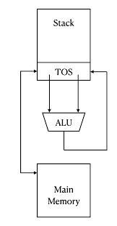
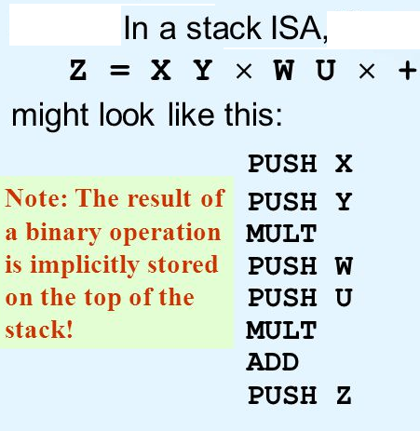
Stack-based ISA: First of all push both operands onto the stack and then simply give an add instruction which will add the top two elements of the stack and then store the result in the stack.

Slide 8
Stack Memory-Memory Accumulator Architecture Extended Accumulator Architecture General-Purpose Register Architecture
Machine | general-purpose registers | Architecture style | Year
Motorola 6800 | 2 | Accumulator | 1974
DEC VAX | 16 | Register-memory memory-memory | 1977
Intel 8086 | 1 | Extended accumulator | 1978
Motorola 68000 | 16 | Register-memory | 1980
Intel 80386 | 32 | Register-memory | 1985
PowerPC | 32 | Load-store | 1992
DEC Alpha | 32 | Load-store | 1992

Slide 9
Accumulator-based
Accumulator is a special purpose register within CPU
Commonly indicated by AC
CPU uses this register in almost all instructions by default and it remains implicit (not written/indicated in instructions)
Results/partial results are also stored in AC by default
CPU
Accumulator
ALU
Control
Unit

Slide 10
Accumulator-based
Memory
CPU
ADDRESS | CONTENTS
200H | 11000101 (DATA)
201H | 11000001 (DATA)
202H | 11000111 (DATA)
Address
Bus
Accumulator(AC)
Data
Bus
ALU
Control
Unit
Control
Bus
Example: LOAD M1 ;M1= 200H
The content of memory location 200H is transferred/copied into AC

Slide 11
Accumulator-based
Memory
CPU
ADDRESS | CONTENTS
200H | 11000101 (DATA)
201H | 11000001 (DATA) 01101101
202H | 11000111 (DATA)
Address
Bus
Accumulator(AC)
01101101
Data
Bus
ALU
Control
Unit
Control
Bus
Example: STOR M2 ;M2 = 201H and [AC] = 01101101
Current content of AC is saved into RAM at 201H

Slide 12
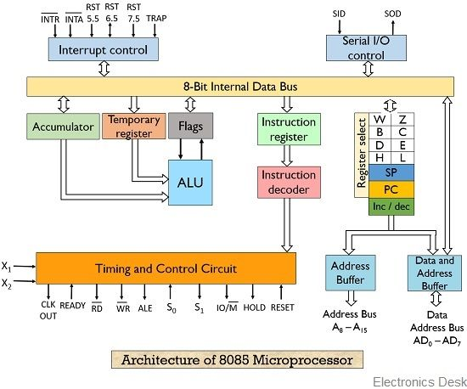
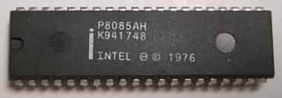
Intel 8085: Accumulator based CPU
Instructions: Accumulator-based CPU
LDA 2034H; the contents of memory location 2034H will be copied into accumulator
ADI 45H ; add 45H to contents of accumulator and stores results to accumulator
ADD B; the contents of register B is added to accumulator and result is stored in accumulator

Slide 13
General purpose
Memory
CPU
ADDRESS | CONTENTS
200H | 11000101 (DATA-1)
201H | 11000001 (DATA-2)
202H | 11000111 (DATA-3)
Address
Bus
AX
Data
Bus
ALU
Control
Unit
Control
Bus
Example: MOV AX, M1 ;M1= 200H
The content of memory location 200H is copied into AX register

Slide 14
General purpose
Memory
CPU
ADDRESS | CONTENTS
200H | 11000101 (DATA-1)
201H | 11000001 (DATA-2) 01101101
202H | 11000111 (DATA-3)
Address
Bus
AX
01101101
Data
Bus
ALU
Control
Unit
Control
Bus
MOV M2, AX ;M2 = 201H
; [AX] = 01101101

Slide 15
Computer Components
Memory
CPU
ADDRESS | CONTENTS
000100100101 (125H) | 11001101 (Machine code of Instruction-1)
000100100110 (126H) | 10001101 (Machine code of Instruction-2)
000100100111 (127H) | 11101101 (Machine code of Instruction-3)
000100101000 (128H) | 11011101 (Machine code of Instruction-4)
200H | 11000101 (DATA-1)
201H | 11000001 (DATA-2)
202H | 11000111 (DATA-3)
PC
MAR
Address
Bus
MDR
Register
File
Data
Bus
IR
ALU
Control
Unit
Control
Bus
PC-Program counter
MAR-Memory Address Register
IR-Instruction Register
MDR-Memory Data Register
Control Unit decodes Instructions & Generates control signals

Slide 16
How does computer work?
User program
SUB AX, BX ;001010111000011
MOV CX, AX ;100010111001000
MOV DX, 0
CPU
Stored in RAM(16 bits)
Address
Bus
PC
MAR
Address | Contents
0001001001010110 (1256H) | 001010111000011
0001001001010111 (1257H) | 100010111001000
Data
Bus
MDR
Register
File
IR
ALU
Control
Unit
Control
Bus

Slide 17
STEP-1: PC is loaded with address of 1st instruction of program
User program
SUB AX, BX ;001010111000011
MOV CX, AX ;100010111001000
MOV DX, 0
CPU
RAM(16 bits)
Address
Bus
PC 1256H
MAR
Address | Contents
1256H | 001010111000011
1257H | 100010111001000
1258H
Data
Bus
MDR
Register
File
IR
ALU
Control
Unit
Control
Bus

Slide 18
STEP-2: content of PC is loaded into MAR
User program
SUB AX, BX
MOV CX, AX
MOV DX, 0
CPU
RAM(16 bits)
Address
Bus
PC 1256H
MAR 1256
Address | Contents
1256H | 001010111000011
1257H | 100010111001000
1258H | 100111111001011
Data
Bus
MDR
Register
File
IR
ALU
Control
Unit
Control
Bus

Slide 19
STEP-3: content of MAR is placed on Address bus and applied to Memory, as a result memory location 1256H is selected
User program
SUB AX, BX
MOV CX, AX
MOV DX, 0
CPU
RAM(16 bits)
Address
Bus 1256H
PC 1256H
MAR 1256H
Address | Contents
1256H | 001010111000011
1257H | 100010111001000
1258H | 100111111001011
Data
Bus
MDR
Register
File
IR
ALU
Control
Unit
Control
Bus

Slide 20
STEP-4: Control unit sends READ control signal to RAM, as a result machine code of 1st instruction is available on Data Bus
User program
SUB AX, BX
MOV CX, AX
MOV DX, 0
CPU
RAM(16 bits)
Address
Bus 1256H
PC 1256H
MAR 1256H
Address | Contents
1256H | 100101011100001
1257H | 100010111001000
1258H | 100111111001011
MDR
Data
Bus
001010111000011
Register
File
IR
ALU
Control
Unit
Control
Bus READ

Slide 21
STEP-5: Machine code of 1st instruction is loaded into IR
User program
SUB AX, BX ;001010111000011
MOV CX, AX ;100010111001000
MOV DX, 0
CPU
RAM(16 bits)
Address
Bus 1256H
PC 1256H
MAR 1256H
Address | Contents
1256H | 001010111000011
1257H | 100010111001000
1258H | 100111111001011
MDR
Register
File
Data
Bus
IR 001010111000011
ALU
Control
Unit
Control
Bus READ

Slide 22
STEP-6: PC is incremented by 1 to point next instruction to be executed. Contents of IR is fed to Control Unit
User program
SUB AX, BX
MOV CX, AX
MOV DX, 0
CPU
RAM(16 bits)
Address
Bus
PC 1257H
MAR
Address | Contents
1256H | 001010111000011
1257H | 100010111001000
1258H | 100111111001011
Data
Bus
MDR
Register
File
IR
Control
Unit
001010111000011
ALU
Control
Bus

Slide 23
STEP-7: 1st instruction is decoded at control unit: control signals are generated to activate ALU for specific operation as per instruction
User program
SUB AX, BX
MOV CX, AX
MOV DX, 0
CPU
RAM(16 bits)
Address
Bus
PC 1257H
MAR
Address | Contents
1256H | 001010111000011
1257H | 100010111001000
1258H | 100111111001011
Data
Bus
MDR
Register
File
IR
Control
Unit
001010111000011
ALU
Control
Bus

Slide 24
STEP-8: 1st instruction is Executed (that includes Data read from RAM followed by ALU operation, result stored as per instruction)
User program
SUB AX, BX
MOV CX, AX
MOV DX, 0
CPU
RAM(16 bits)
Address
Bus
PC 1257H
MAR
Address | Contents
1256H | 001010111000011
1257H | 100010111001000
1258H | 100111111001011
Data
Bus
MDR
Register
File
IR
Control
Unit
001010111000011
ALU
Control
Bus

Slide 25
STEPS-2:8 repeated for next instruction content of PC is loaded into MAR
User program
SUB AX, BX
MOV CX, AX
MOV DX, 0
CPU
RAM(16 bits)
Address
Bus
PC 1257H
MAR 1257H
Address | Contents
1256H | 001010111000011
1257H | 100010111001000
1258H | 100111111001011
Data
Bus
MDR
Register
File
IR
ALU
Control
Unit
Control
Bus

Slide 27
Instruction Formats (3-operand fields)
ADD M, D1, D2
[M] D1+ D2
Binary code for ALU operation (Op Code) | Memory address to store result (Binary) | Data -1 (Binary) | Data-2 (Binary)
ADD M1, M2, M3
[M1] [M2]+ [M3]
Binary code for ALU operation (Op Code) | Memory address to store result (Binary) | Memory address of Data -1 (Binary) | Memory address of Data-2 (Binary)
ADD R1, R2, R3
R1 R2+ R3
Binary code for ALU operation (Op Code) | CPU Register to store result (Binary) | CPU register containing Data -1 (Binary) | CPU register containing Data -1 (Binary)

Slide 28
Instruction Formats(2-operand field)
ADD M1, M2
[M1] [M1]+ [M2]
Binary code for ALU operation (Op Code) | CPU register or memory address that contains Data-1 (Binary) Result is stored in same CPU register or memory address after operation | CPU register or memory address that contains Data-2 (Binary)
ADD R1, R2
R1 R1 + R2
ADD M, R1
[M] R1 + [M]

Slide 29
Instruction Formats(one-operand field)
ADD M
AC [M] + AC
Binary code for ALU operation (Op Code) | CPU register or memory address that contains Data-2 (Binary)
Here Data-1 should be loaded into a predefined register, namely Accumulator (AC) prior to use this instruction. Moreover, the result is stored into Accumulator (AC) as well. Interestingly, the Accumulator (AC) is not explicitly indicated in the Instruction sub-field!
ADD R1
AC R1 + AC

Slide 30
Instruction Formats(Opcode only!)
CLC
Clear carry Flag bit
Binary code for ALU /special operation
Data to be used should be initially loaded into default CPU register. Result is also stored there as well.

Slide 31
Format of an Instruction
OP CODE 4-BITS | OPERAND FIELD-1 4-BITS | OPERAND FIELD-2 4-BITS | OPERAND FIELD-3 4-BITS
OP CODE 4-BITS | OPERAND FIELD-1 4-BITS | OPERAND FIELD-2 4-BITS
OP CODE 8-BITS | OPERAND FIELD-1 16-BITS | OPERAND FIELD-2 16-BITS
Notes:
3

Slide 32

Machine Codes
An instruction can be coded with 1 to 6 bytes
Byte 1 contains three kinds of information
– Opcode field (6 bits) specifies the operation (add, subtract, move)
– Register Direction Bit (D bit) Tells the register operand in REG field in byte 2 is source or destination operand
1: destination 0: source
-Data Size Bit (W bit) Specifies whether the operation will be performed on 8-bit or 16-bit data
0: 8 bits 1: 16 bits
15 ------- 10 | 9 | 8 | 7 ---- 6 | 5 ---- 3 | 2 ---- 0

Slide 33
Example: MOV BL, AL (machine code: 10001000 11000011) (Hexcode: 88 C3H)
1 0 0 0 1 0 | 0 | 0 | 1 1 | 0 0 0 | 0 1 1
Opcode = 100010 MOV data transfer
D = 0 AL is source operand
W = 0 8-bit data transfer
Therefore byte 1 is 10001000₂=88₁₆
MOD = 11 register mode
REG = 000 code for AL
R/M = 011 destination is BL
Therefore Byte 2 is 11000011₂=C3₁₆

Slide 34
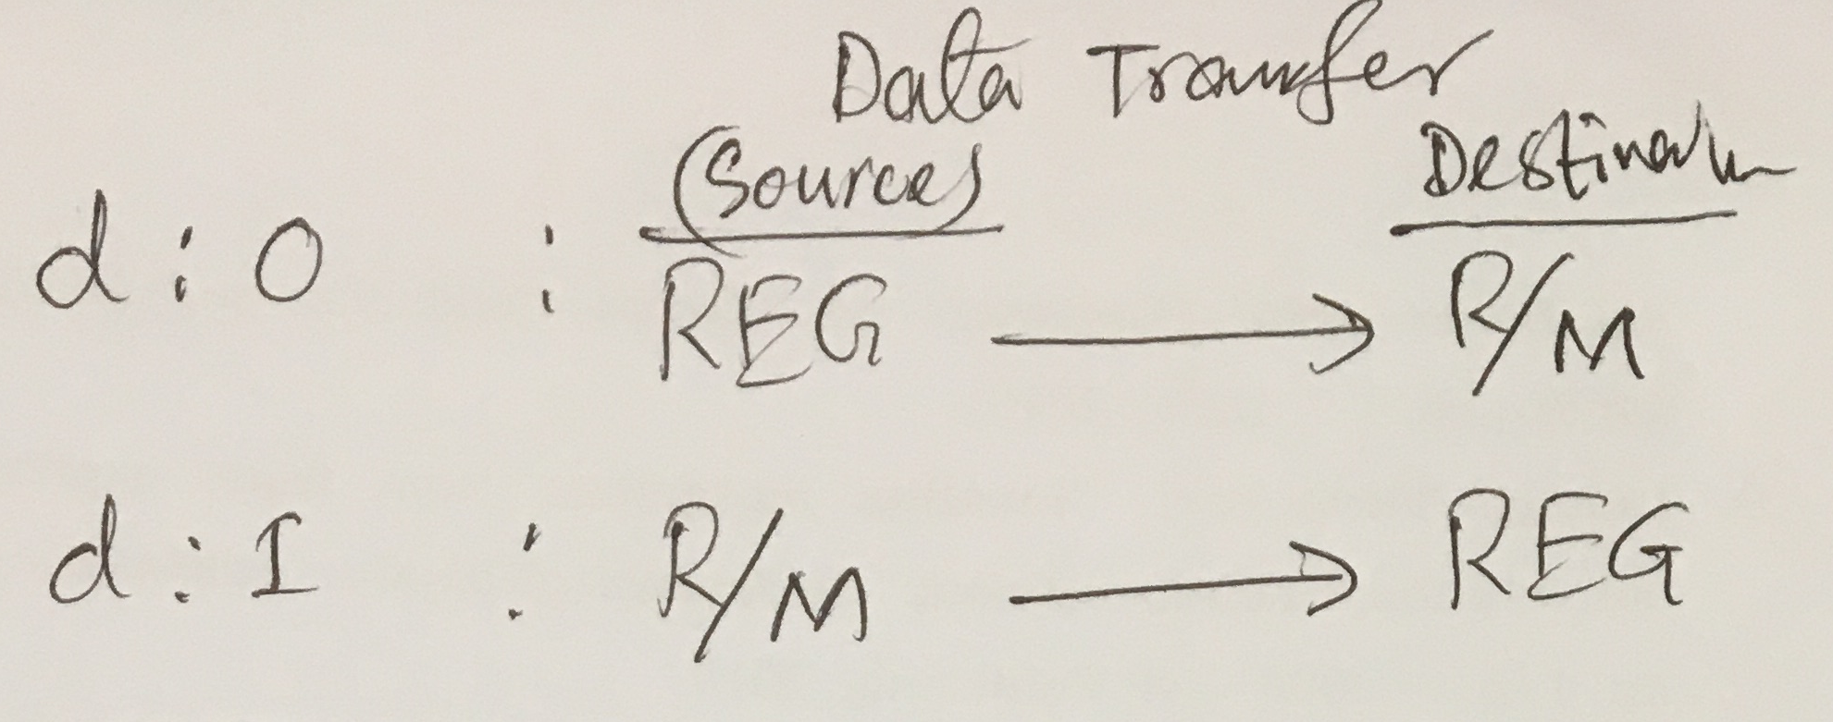
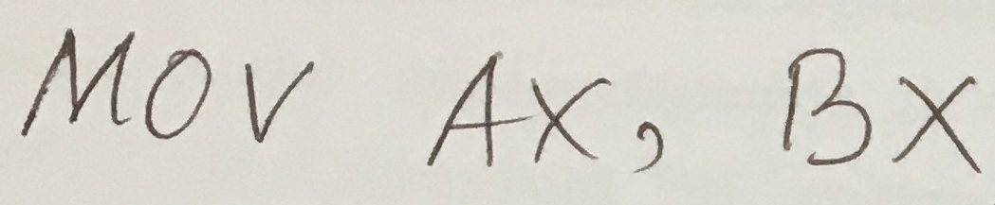
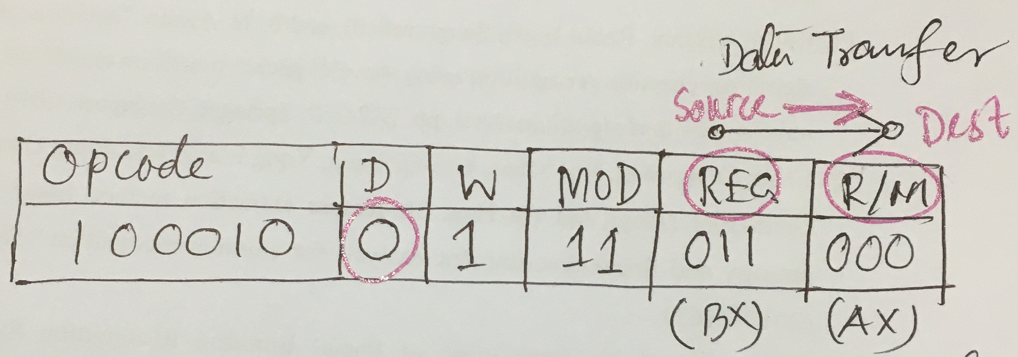
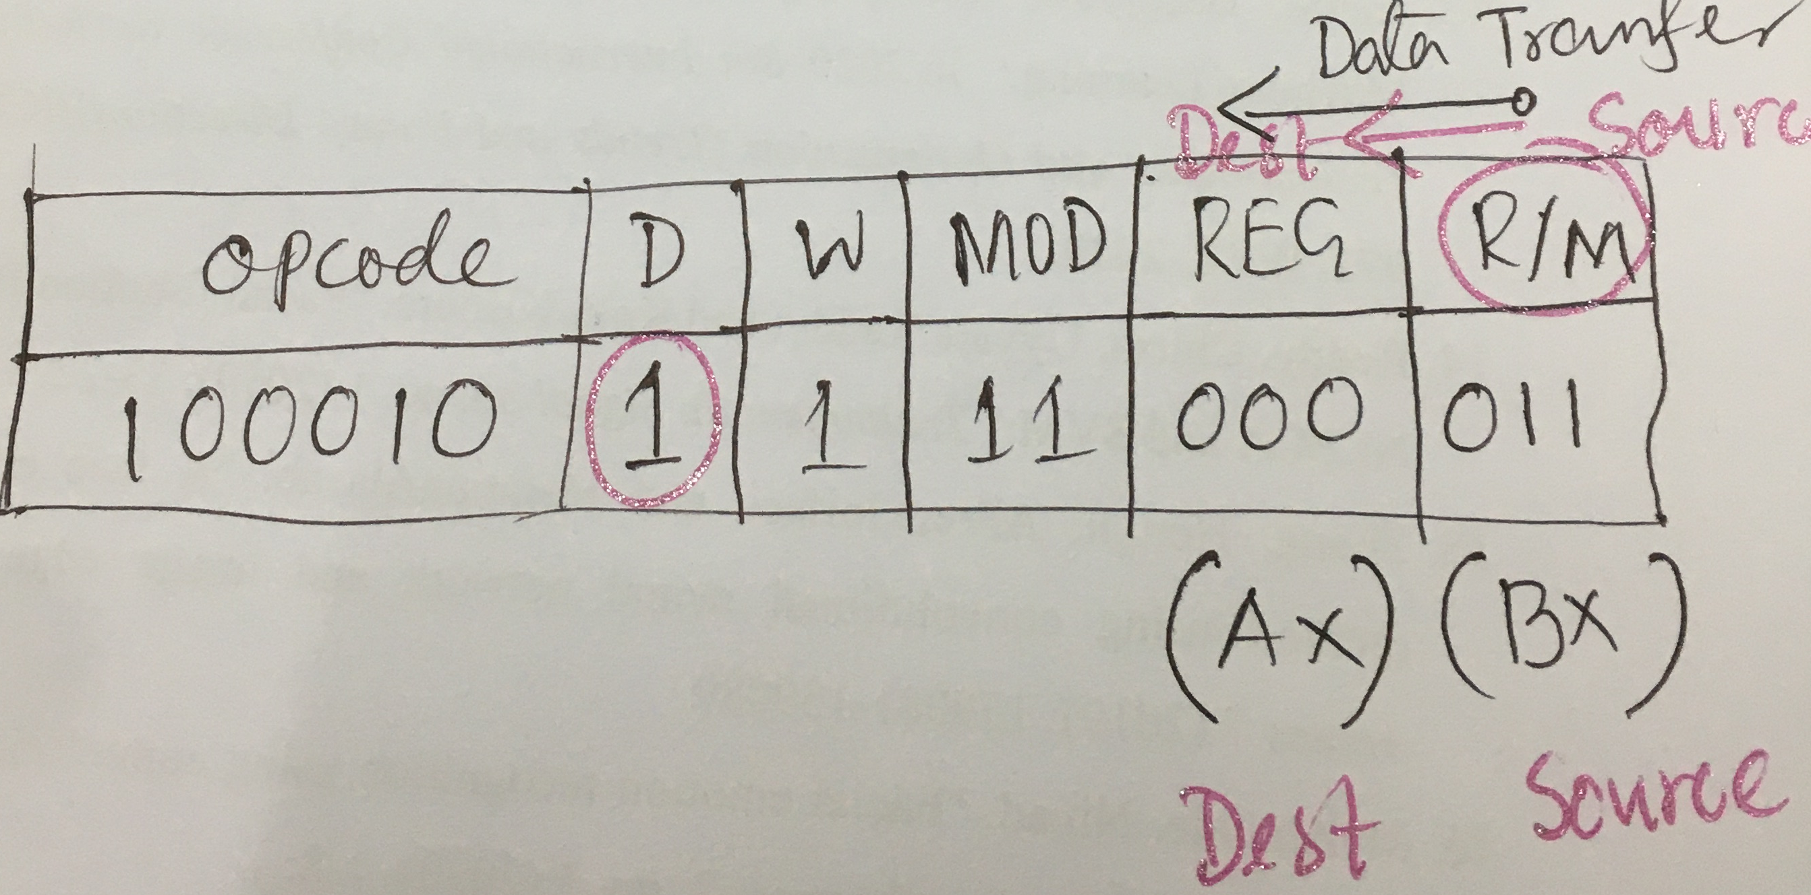

Slide 35
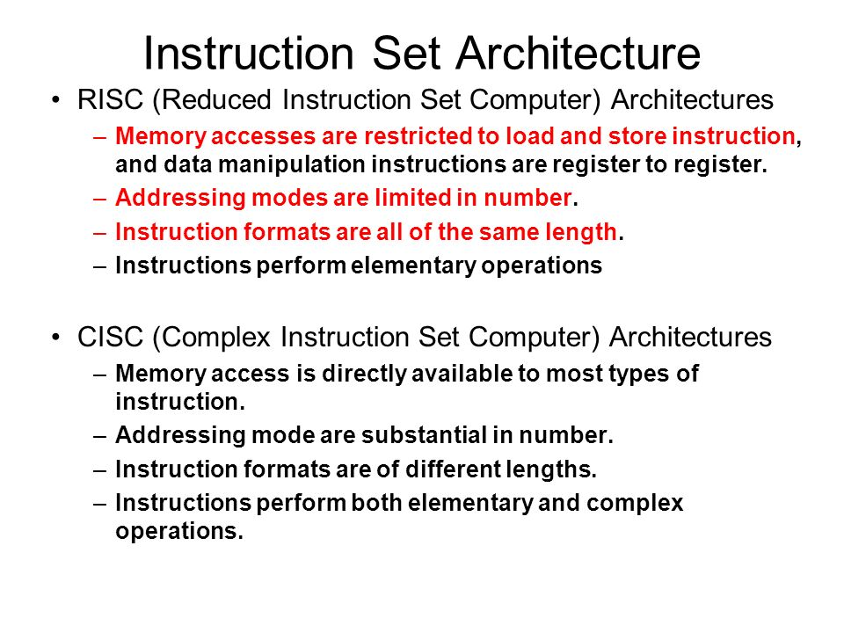

Slide 36
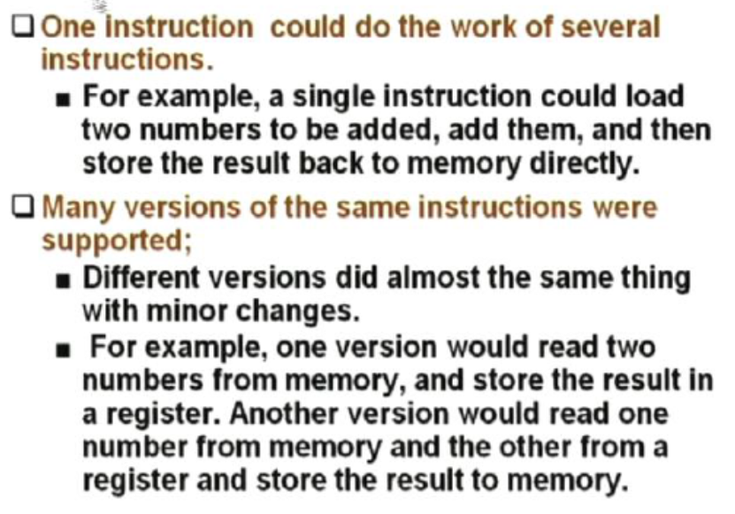
CISC features

Slide 37
RISC Processors

Slide 38
Background of RISC
IBM RISC technology originated in 1974 in a project to design a large telephone-switching network capable of handing an average of three hundred calls per second. With an approximate 20 000 instructions per call and Stringent real-time response requirements, the performance target was 12 million instructions per second (MIPS).
This specialized application required a very fast processor, but did not have to perform computed instructions and had little demand for floating-point calculations. Other than moving data between registers and memory, the machine had to be able to add, combine fields extracted from several registers, perform branches, and carry out input/output operations.

Slide 39
Background of RISC
When the telephone project was terminated in 1975, the machine itself had not been built, but the design had progressed to the point where it seemed to be an excellent basis for a general-purpose, high-performance miniprocessor. The attractiveness of the processor design stemmed from projections that it would be able to compute at high speed relative to its cost in a variety of application areas.
The most important features of the telephone switching machine which contributed to its low cost/performance ratio were 1) separate instruction and data caches, allowing a much higher bandwidth between memory and CPU; 2) no arithmetic operations to storage, which greatly simplified the pipeline; and 3) uniform instruction length and simplicity of design, making possible a very short cycle time: ten levels of logic. (For example, all register-to-register operations executed in one cycle.)

Slide 40



Background of RISC
John Cocke and his colleagues developed simpler ISAs and compilers for minicomputers. As an experiment, they retargeted their research compilers to use only the simple register-register operations and load-store data transfers of the IBM 360 ISA, avoiding the more complicated instructions. They found that programs ran up to three times faster using the simple subset.
Emer and Clark found 20% of the VAX instructions needed 60% of the microcode and represented only 0.2% of the execution time.

Slide 41
RISC: Reduced Instruction Set Computer
A type of microprocessor architecture that utilizes a small, highly-optimized set of instructions
History: The first RISC projects came from IBM, Stanford, and UC-Berkeley in the late 70s and early 80s. The IBM 801, Stanford MIPS, and Berkeley RISC 1 and 2 were all designed with a similar philosophy.
Design features of RISC processors:
one cycle execution time: RISC processors have a CPI (clock per instruction) of one cycle. This is due to the optimization of each instruction on the CPU and a technique called pipelining;
pipelining: a technique that allows for simultaneous execution of parts, or stages, of instructions to more efficiently process instructions;
large number of registers: RISC design philosophy generally incorporates a larger number of registers to prevent in large amounts of interactions with memory

Slide 42
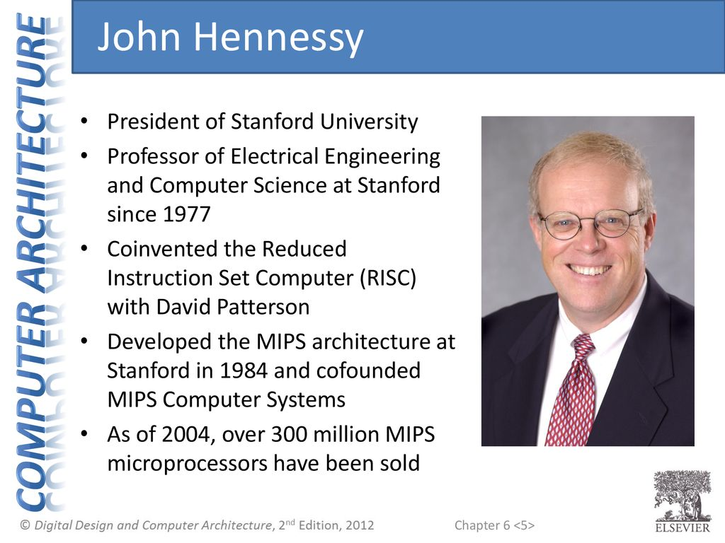
MIPS
The MIPS processor was developed as part of a VLSI research program at Stanford University in the early 80s.
Professor John Hennessy started the development of MIPS with a brainstorming class for graduate students. The readings and idea sessions helped launch the development of the processor which became one of the first RISC processors, with IBM and Berkeley developing processors at around the same time.

Slide 43
MIPS Architecture
The Stanford research group had a strong background in compilers, which led them to develop a processor whose architecture would represent the lowering of the compiler to the hardware level, as opposed to the raising of hardware to the software level, which had been a long running design philosophy in the hardware industry.
Thus, the MIPS processor implemented a smaller, simpler instruction set. Each of the instructions included in the chip design ran in a single clock cycle. The processor used a technique called pipelining to more efficiently process instructions.
MIPS used 32 registers, each 32 bits wide (a bit pattern of this size is referred to as a word).

Slide 44
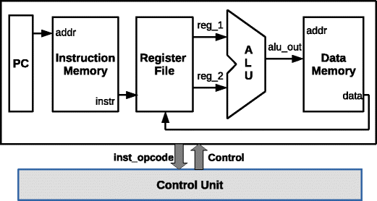
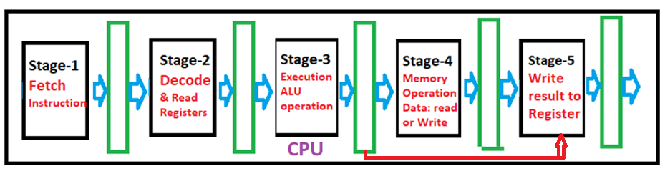
Instruction cycle of MIPS processor was subdivided into five stages:
Instruction Fetch (IF)
Instruction Decode (ID) and Register Read
Execution (EXE)
Memory read/write(MEM)
Write Back result (WB) to Registers

Slide 45
Instruction\ clock cycles | 1 | 2 | 3 | 4 | 5 | 6 | 7 | 8
Instruction-1 | IF | ID | EX | MA | WB
Instruction-2 |  | IF | ID | EX | MA | WB
Instruction-3 |  |  | IF | ID | EX | MA | WB
Instruction-4 |  |  |  | IF | ID | EX | MA
Instruction-5 |  |  |  |  | IF | ID | EX
Instruction-6 |  |  |  |  |  | IF | ID
Instruction-7 |  |  |  |  |  |  | IF
Single cycle implementation

Slide 46
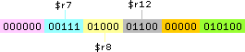
Instruction Set
The MIPS instruction set consists of about 111 total instructions, each represented in 32 bits. An example of a MIPS instruction is below:
add $r12, $r7, $r8,
Three-operand arithmetical and logical instructions and all instructions are 32-bit
Arithmetical and logical instructions are Register based (operands in registers and result will be stored in register)
32 general-purpose registers of 32-bits each
MIPS addition instruction. The instruction tells the processor to compute the sum of the values in registers 7 and 8 and store the result in register 12. The dollar signs are used to indicate an operation on a register. The colored binary representation on the right illustrates the 6 fields of a MIPS instruction. The processor identifies the type of instruction by the binary digits in the first and last fields. In this case, the processor recognizes that this instruction is an addition from the zero in its first field and the 20 in its last field.
The operands are represented in the blue and yellow fields, and the desired result location is presented in the fourth (purple) field. The orange field represents the shift amount, something that is not used in an addition operation.

Slide 47
The instruction set consists of about 111 total instructions. A variety of basic instructions, including:
21 arithmetic instructions (+, -, *, /, %)
8 logic instructions (&, |, ~)
8 bit manipulation instructions
12 comparison instructions (>, <, =, >=, <=, ¬)
25 branch/jump instructions
15 load instructions
10 store instructions
8 move instructions
4 miscellaneous instructions

Slide 48
How Pipelining Works
Pipelining, a standard feature in RISC processors, is much like an assembly line. Because the processor works on different steps of the instruction at the same time, more instructions can be executed in a shorter period of time.
CPI = 1
Instruction\ clock cycles | 1 | 2 | 3 | 4 | 5 | 6 | 7 | 8
Instruction-1 | IF | ID | EX | MA | WB
Instruction-2 |  | IF | ID | EX | MA | WB
Instruction-3 |  |  | IF | ID | EX | MA | WB
Instruction-4 |  |  |  | IF | ID | EX | MA
Instruction-5 |  |  |  |  | IF | ID | EX
Instruction-6 |  |  |  |  |  | IF | ID
Instruction-7 |  |  |  |  |  |  | IF
Non-pipelined processor (CPI = 5)
Instruction/Clock cycles | 1 | 2 | 3 | 4 | 5 | 6 | 7 | 8 | 9 | 10 | 11 | 12 | 13 | 14 | 15
Instruction-1 | IF | ID | EX | MEM | WB
Instruction-2 |  |  |  |  |  | IF | ID | EX | MEM | WB
Instruction-3 |  |  |  |  |  |  |  |  |  |  | IF | ID | EX | MEM | WB

Slide 49
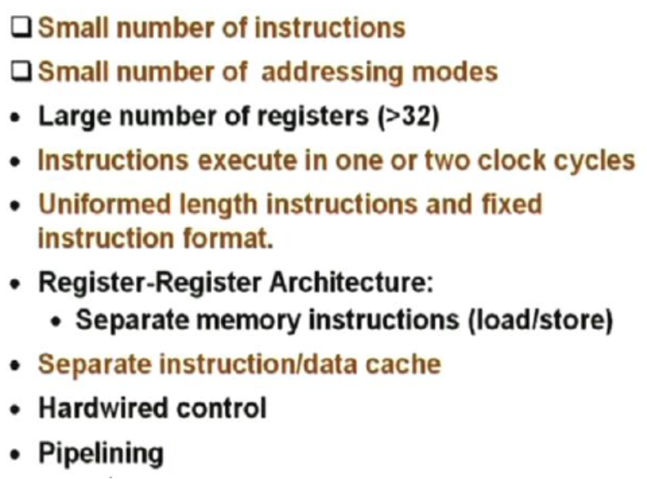
Features of RISC Processors

Slide 50
CISC features

Slide 51
RISC vs CISC
The formula for processor performance:
Time/Program = Instructions /Program × (Clock cycles) /Instruction × Time/ (Clock cycle)
DEC engineers later showed that the more complicated CISC ISA executed about 75% of the number instructions per program as RISC (the first term), but in a similar technology CISC executed about five to six more clock cycles per instruction (the second term), making RISC microprocessors approximately 4× faster.

Slide 52
RISC Pipelines
A RISC processor pipeline operates in much the same way, although the stages in the pipeline are different. While different processors have different numbers of steps, they are basically variations of these five, used in the MIPS R3000 processor:
fetch instructions from memory
read registers and decode the instruction
execute the instruction or calculate an address
access an operand in data memory
write the result into a register
If you glance back at the diagram of the laundry pipeline, you'll notice that although the washer finishes in half an hour, the dryer takes an extra ten minutes, and thus the wet clothes must wait ten minutes for the dryer to free up. Thus, the length of the pipeline is dependent on the length of the longest step. Because RISC instructions are simpler than those used in pre-RISC processors (now called CISC, or Complex Instruction Set Computer), they are more conducive to pipelining. While CISC instructions varied in length, RISC instructions are all the same length and can be fetched in a single operation. Ideally, each of the stages in a RISC processor pipeline should take 1 clock cycle so that the processor finishes an instruction each clock cycle and averages one cycle per instruction (CPI).

Slide 53
Pipeline Problems
In practice, however, RISC processors operate at more than one cycle per instruction. The processor might occasionally stall a result of data dependencies and branch instructions.
A data dependency occurs when an instruction depends on the results of a previous instruction. A particular instruction might need data in a register which has not yet been stored since that is the job of a preceding instruction which has not yet reached that step in the pipeline.

Slide 54
For example:
add $r3, $r2, $r1
add $r5, $r4, $r3
In this example, the first instruction tells the processor to add the contents of registers r1 and r2 and store the result in register r3.
The second instructs it to add r3 and r4 and store the sum in r5. We place this set of instructions in a pipeline. When the second instruction is in the second stage, the processor will be attempting to read r3 and r4 from the registers. Remember, though, that the first instruction is just one step ahead of the second, so the contents of r1 and r2 are being added, but the result has not yet been written into register r3. The second instruction therefore cannot read from the register r3 because it hasn't been written yet and must wait until the data it needs is stored. Consequently, the pipeline is stalled and a number of empty instructions (known as bubbles go into the pipeline. Data dependency affects long pipelines more than shorter ones since it takes a longer period of time for an instruction to reach the final register-writing stage of a long pipeline.

Slide 55
data dependency
MIPS' solution to this problem is code reordering. If, as in the example above, the following instructions have nothing to do with the first two, the code could be rearranged so that those instructions are executed in between the two dependent instructions and the pipeline could flow efficiently. The task of code reordering is generally left to the compiler, which recognizes data dependencies and attempts to minimize performance stalls.

Slide 56
Branch instructions
Branch instructions are those that tell the processor to make a decision about what the next instruction to be executed should be based on the results of another instruction. Branch instructions can be troublesome in a pipeline if a branch is conditional on the results of an instruction which has not yet finished its path through the pipeline.
Loop: add $r3, $r2, $r1
sub $r6, $r5, $r4
beq $r3, $r6, loop
The example above instructs the processor to add r1 and r2 and put the result in r3, then subtract r4 from r5, storing the difference in r6. In the third instruction, beq stands for branch if equal. If the contents of r3 and r6 are equal, the processor should execute the instruction labeled "Loop." Otherwise, it should continue to the next instruction. In this example, the processor cannot make a decision about which branch to take because neither the value of r3 or r6 have been written into the registers yet.

Slide 57
The processor could stall, but a more sophisticated method of dealing with branch instructions is branch prediction. The processor makes a guess about which path to take - if the guess is wrong, anything written into the registers must be cleared, and the pipeline must be started again with the correct instruction. Some methods of branch prediction depend on stereotypical behavior. Branches pointing backward are taken about 90% of the time since backward-pointing branches are often found at the bottom of loops. On the other hand, branches pointing forward, are only taken approximately 50% of the time. Thus, it would be logical for processors to always follow the branch when it points backward, but not when it points forward. Other methods of branch prediction are less static: processors that use dynamic prediction keep a history for each branch and uses it to predict future branches. These processors are correct in their predictions 90% of the time.
Still other processors forgo the entire branch prediction ordeal. The RISC System/6000 fetches and starts decoding instructions from both sides of the branch. When it determines which branch should be followed, it then sends the correct instructions down the pipeline to be executed.

Slide 58
CISC | RISC
Emphasis on hardware | Emphasis on software
Includes multi-clock complex instructions | Single-clock, reduced instruction only
Memory-to-memory: "LOAD" and "STORE" incorporated in instructions | Register to register: "LOAD" and "STORE" are independent instructions
Small code sizes, high cycles per second | Low cycles per second, large code sizes
Transistors used for storing complex instructions | Spends more transistors on memory registers

Slide 59
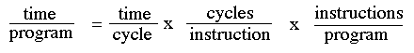
The Performance Equation
The following equation is commonly used for expressing a computer's performance ability:
The CISC approach attempts to minimize the number of instructions per program, sacrificing the number of cycles per instruction. RISC does the opposite, reducing the cycles per instruction at the cost of the number of instructions per program.

Slide 60
The Overall RISC Advantage
Today, the Intel x86 is arguable the only chip which retains CISC architecture. This is primarily due to advancements in other areas of computer technology. The price of RAM has decreased dramatically. In 1977, 1MB of DRAM cost about $5,000. By 1994, the same amount of memory cost only $6 (when adjusted for inflation). Compiler technology has also become more sophisticated, so that the RISC use of RAM and emphasis on software has become ideal.

Slide 61
RISC vs CISC
The formula for processor performance:
Time/Program = Instructions /Program × (Clock cycles) /Instruction × Time/ (Clock cycle)
DEC engineers later showed that the more complicated CISC ISA executed about 75% of the number instructions per program as RISC (the first term), but in a similar technology CISC executed about five to six more clock cycles per instruction (the second term), making RISC microprocessors approximately 4× faster.

Slide 63
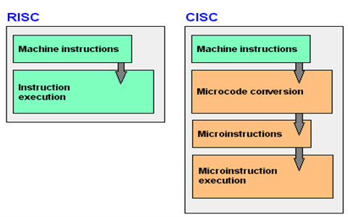

Slide 64
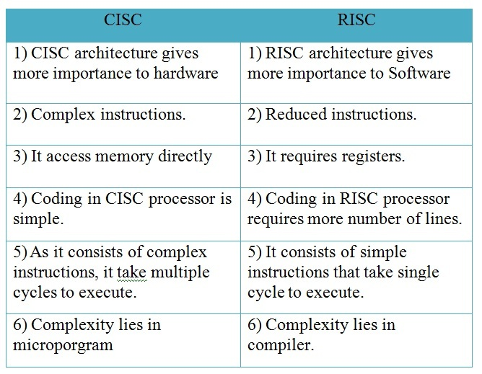

Slide 65
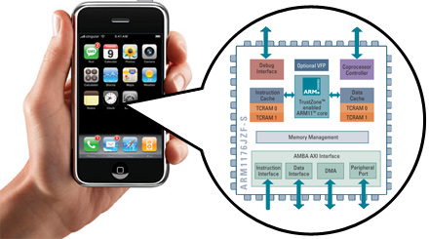
Advanced RISC Machine (ARM) instruction set inside the iPhone
You will how to design and program a related RISC computer: MIPS

Slide 66
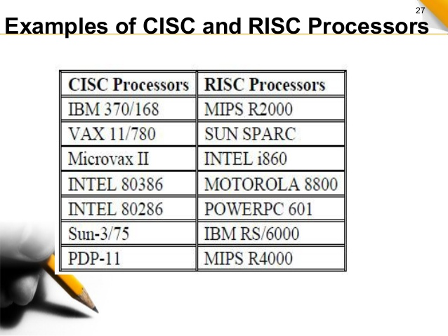

Slide 67
The CISC Approach The primary goal of CISC architecture is to complete a task in as few lines of assembly as possible. This is achieved by building processor hardware that is capable of understanding and executing a series of operations. For this particular task, a CISC processor would come prepared with a specific instruction (we'll call it "MULT"). When executed, this instruction loads the two values into separate registers, multiplies the operands in the execution unit, and then stores the product in the appropriate register. Thus, the entire task of multiplying two numbers can be completed with one instruction: MULT M1, M2 MULT is what is known as a "complex instruction." It operates directly on the computer's memory banks and does not require the programmer to explicitly call any loading or storing functions. It closely resembles a command in a higher level language. For instance, if we let "a" represent the value of memory M1 and "b" represent the value of memory M2, then this command is identical to the C statement “[M1] = [M1] x [M2]" One of the primary advantages of this system is that the compiler has to do very little work to translate a high-level language statement into assembly. Because the length of the code is relatively short, very little RAM is required to store instructions. The emphasis is put on building complex instructions directly into the hardware.

Slide 68
The RISC Approach RISC processors only use simple instructions that can be executed within one clock cycle. Thus, the "MULT" command described above could be divided into three separate commands: "LOAD," which moves data from the memory bank to a register, "PROD," which finds the product of two operands located within the registers, and "STORE," which moves data from a register to the memory banks. In order to perform the exact series of steps described in the CISC approach, a programmer would need to code four lines of assembly: LOAD A, M1 LOAD B, M2 PROD A, B STORE M1, A At first, this may seem like a much less efficient way of completing the operation. Because there are more lines of code, more RAM is needed to store the assembly level instructions. The compiler must also perform more work to convert a high-level language statement into code of this form.

Slide 69
Background of RISC
John Cocke and his colleagues developed simpler ISAs and compilers for minicomputers. As an experiment, they retargeted their research compilers to use only the simple register-register operations and load-store data transfers of the IBM 360 ISA, avoiding the more complicated instructions. They found that programs ran up to three times faster using the simple subset.
Emer and Clark found 20% of the VAX instructions needed 60% of the microcode and represented only 0.2% of the execution time.

Slide 70
RISC
First, the RISC instructions were simplified so there was no need for a microcoded interpreter. The RISC instructions were typically as simple as microinstructions and could be executed directly by the hardware.
Second, the fast memory, formerly used for the microcode interpreter of a CISC ISA, was repurposed to be a cache of RISC instructions. (A cache is a small, fast memory that buffers recently executed instructions, as such instructions are likely to be reused soon.)
Third, register allocators based on Gregory Chaitin’s graph-coloring scheme made it much easier for compilers to efficiently use registers, which benefited these register-register ISAs

Slide 71
Time/Program = Instructions /Program × (Clock cycles) /Instruction × Time / (Clock cycle)
DEC engineers later showed2 that the more complicated CISC ISA executed about 75% of the number instructions per program as RISC (the first term), but in a similar technology CISC executed about five to six more clock cycles per instruction (the second term), making RISC microprocessors approximately 4× faster.

Slide 72
